Slide 1
Global Gateway-Energy and Transport in Africa
Georgios GRAPSAS – Policy officer
Regional and multicountry programmes for Africa
DG INTPA.A.2 – European Commission
Thursday, 30th November 2023
#TeamEurope #GlobalGateway

Slide 2

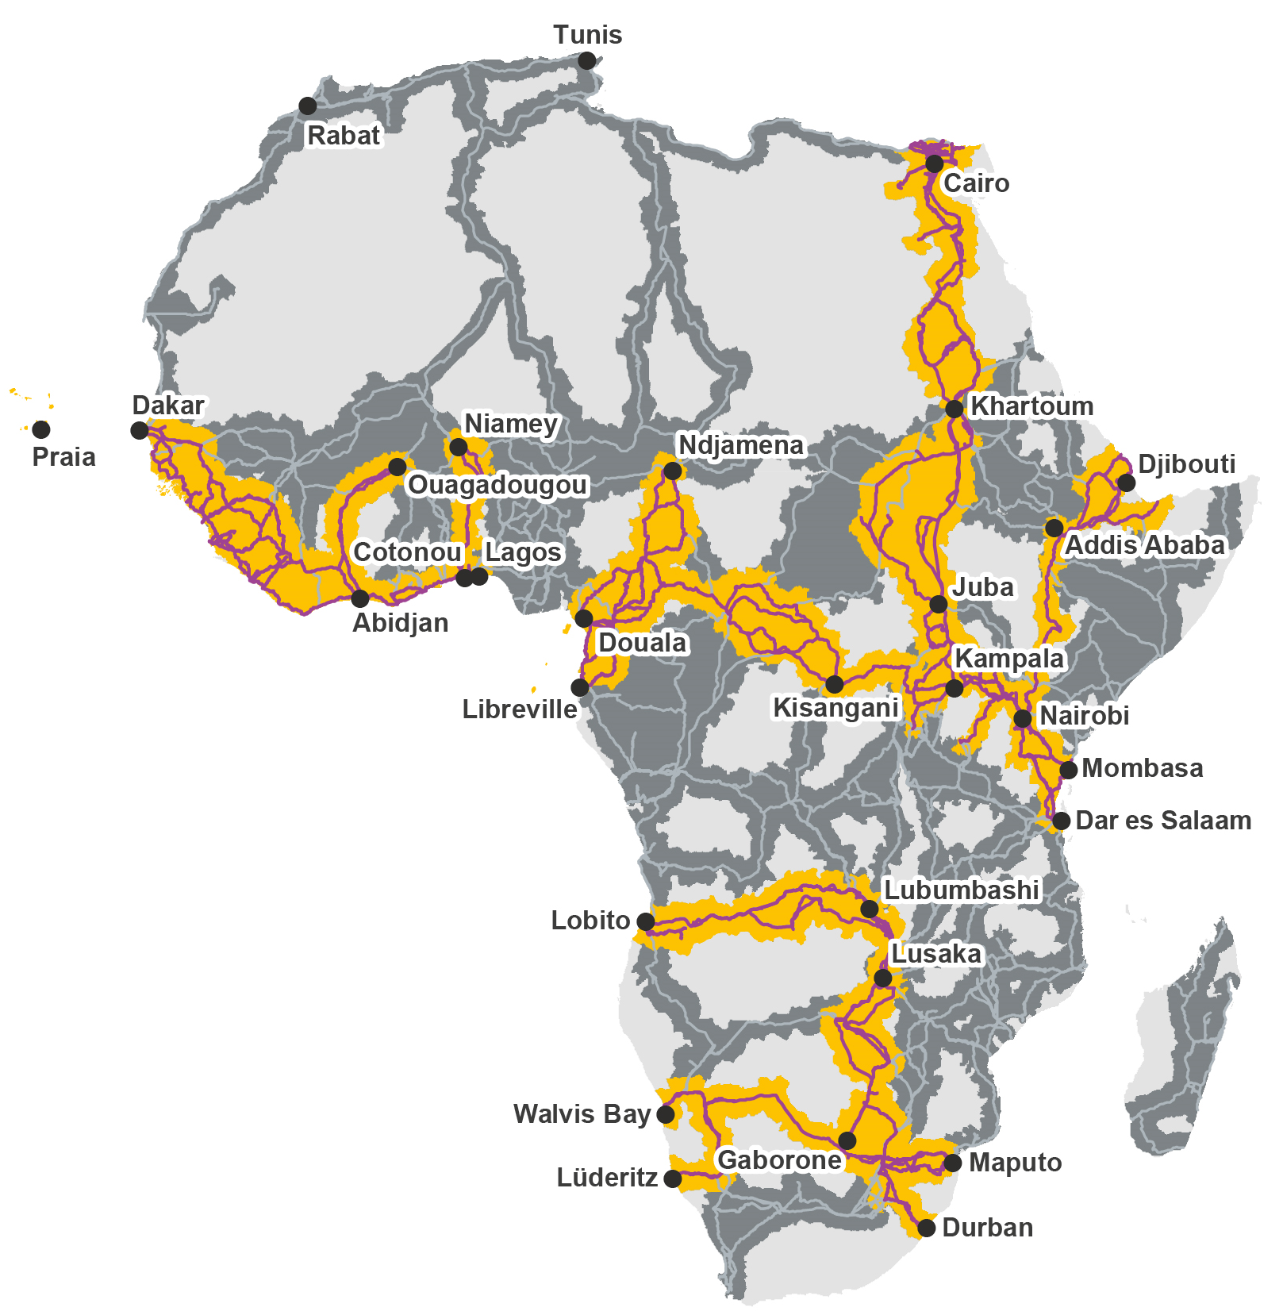
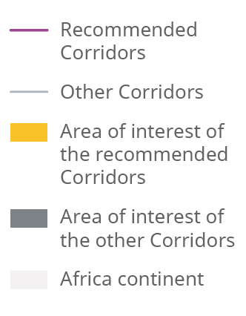

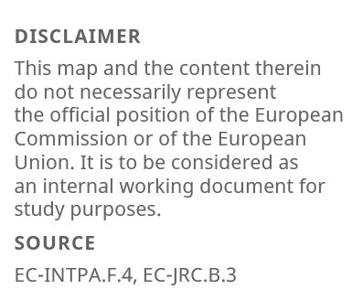

Transport – 12 Strategic Corridors in Africa
1. Abidjan-Lagos
West Africa: Côte d’Ivoire, Ghana, Togo, Benin, Nigeria
2. Abidjan-Ouagadougou
West Africa: Côte d’Ivoire, Burkina Faso
3.Praia - Dakar-Abidjan
West Africa: Senegal, Gambia, Guinea-Bissau, Guinea, Sierra Leone, Liberia, Côte d’Ivoire, Cabo Verde
4. Cotonou-Niamey
West Africa: Benin, Niger
5. Libreville-Kribi-Douala-N’Djamena
Central Africa: Gabon, Equatorial Guinea, Cameroon, Chad, São Tomé and Príncipe
6. Douala-Kribi-Kampala
Central Africa: Cameroon, Central African Republic, Democratic Republic of the Congo, Uganda
7. Dar es Salaam-Nairobi-Addis Ababa-Berbera-Djibouti
East Africa: Tanzania, Kenya, Ethiopia, Somalia, Djibouti
8. Mombasa-Kisangani
East Africa: Kenya, Uganda, Rwanda, Democratic Republic
of the Congo
9. Maputo-Gaborone-Walvis Bay
Southern Africa: Mozambique, South Africa, Eswatini, Botswana, Namibia
10. Durban-Lusaka
Southern Africa: South Africa, Botswana, Zimbabwe, Zambia
11. Cairo-Khartoum-Juba-Kampala
North and East Africa: Egypt, Soudan, South Sudan, Uganda
12. Lobito - Lubumbashi
Angola- Zambia - DRC
A study by the EU Joint Research Center
#GlobalGateway #TeamEurope

Slide 3
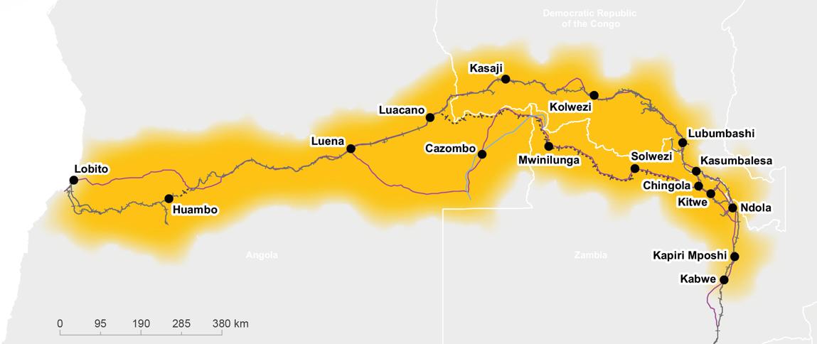
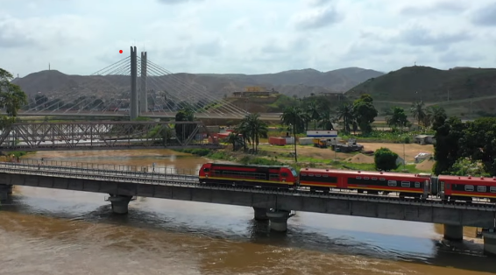
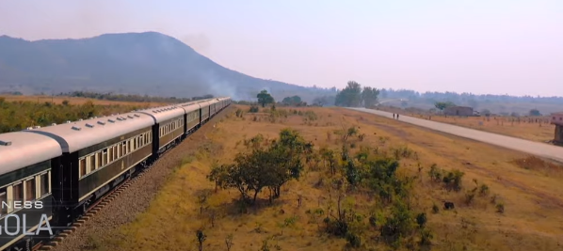
Flagship project : Lobito railway corridor Angola-Zambia-Democratic Rep of Congo
DRC
ANGOLA
ZAMBIA
Lobito Corridor will include 700 km of a greenfield metric railway line in Zambia following the 600km that exist already in Angola
Link with export of mining (copper and critical raw materials to Western markets)
Expected investment of around 3 billion EUR
MOU signed in Brussels in October between US, EU, AfDB, Zambia, Angola, DRC
#GlobalGateway #TeamEurope

Slide 4
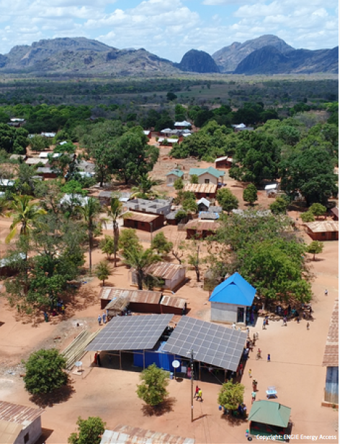
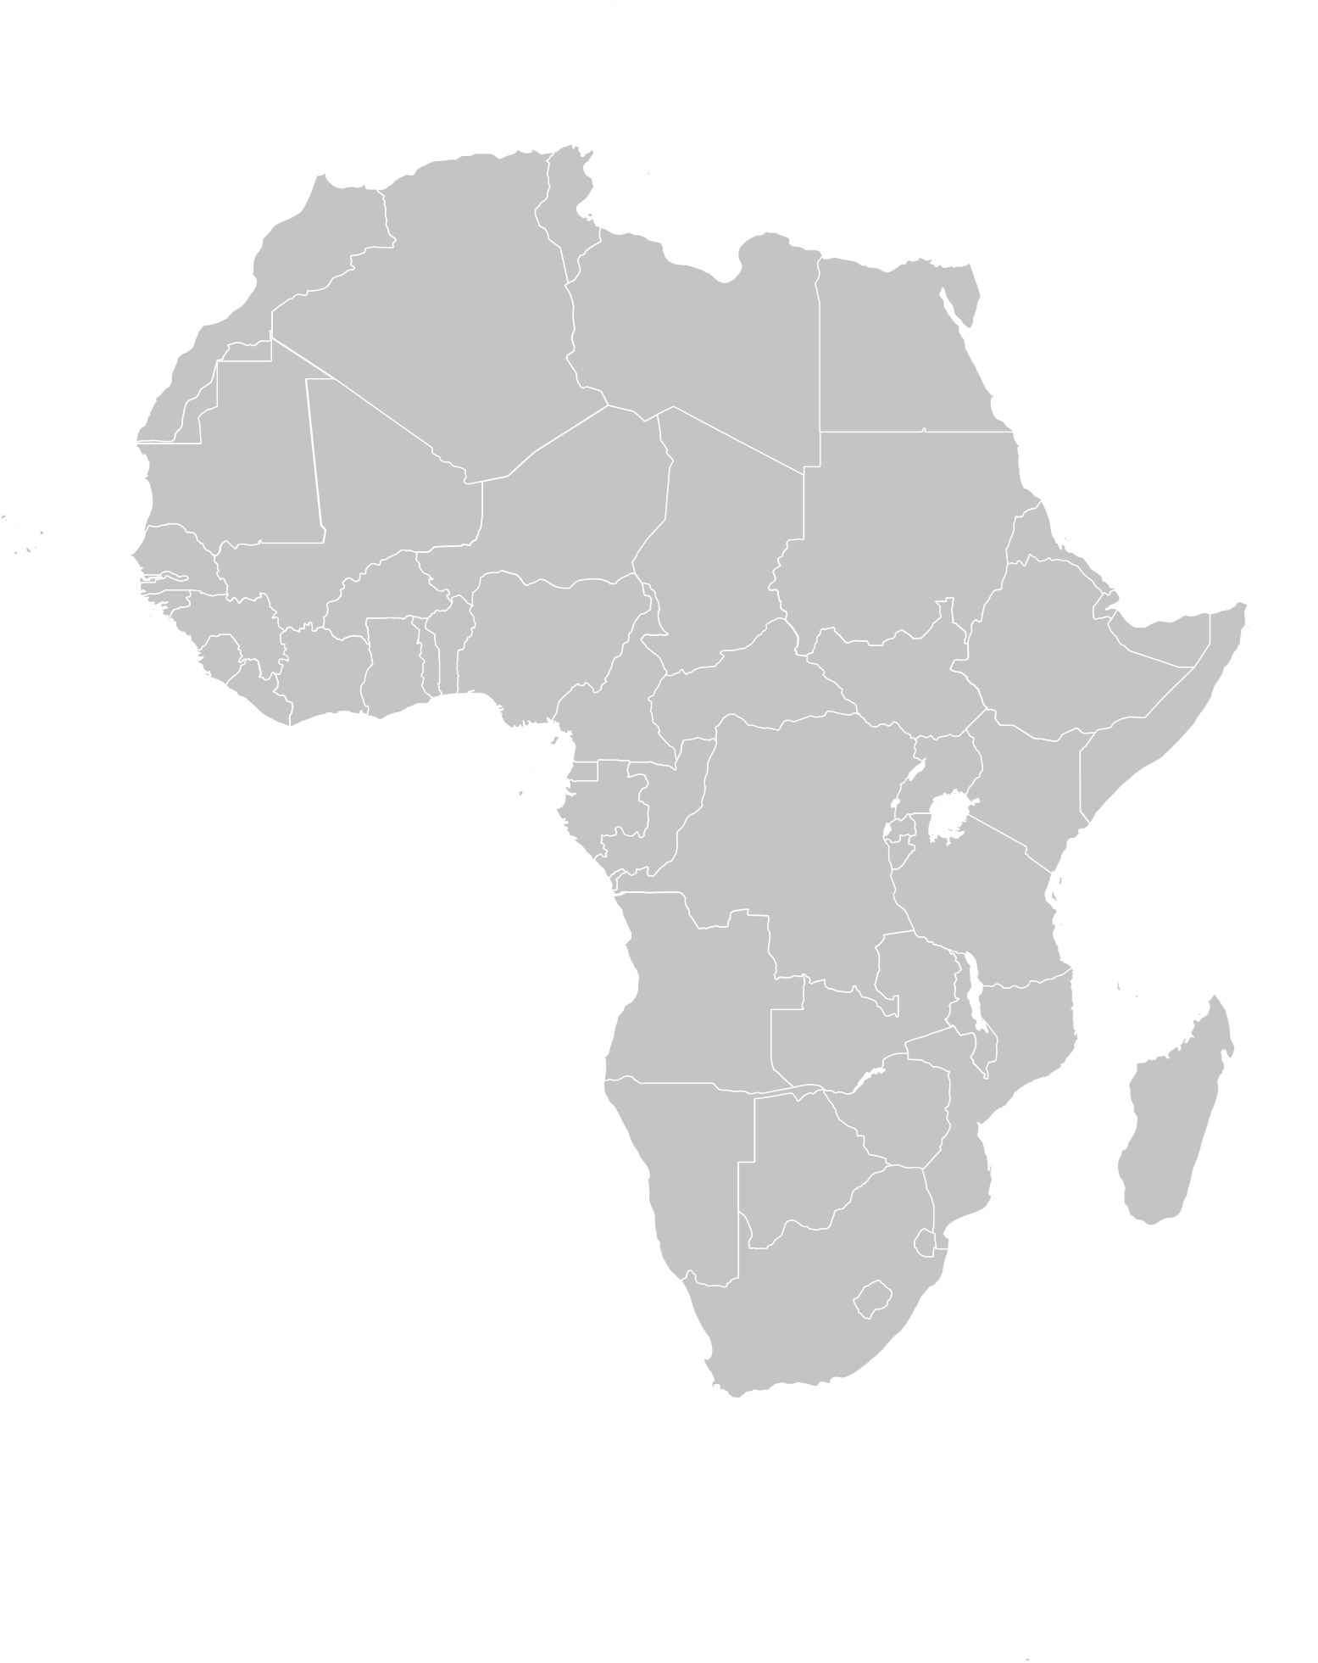


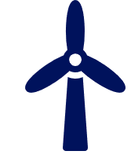
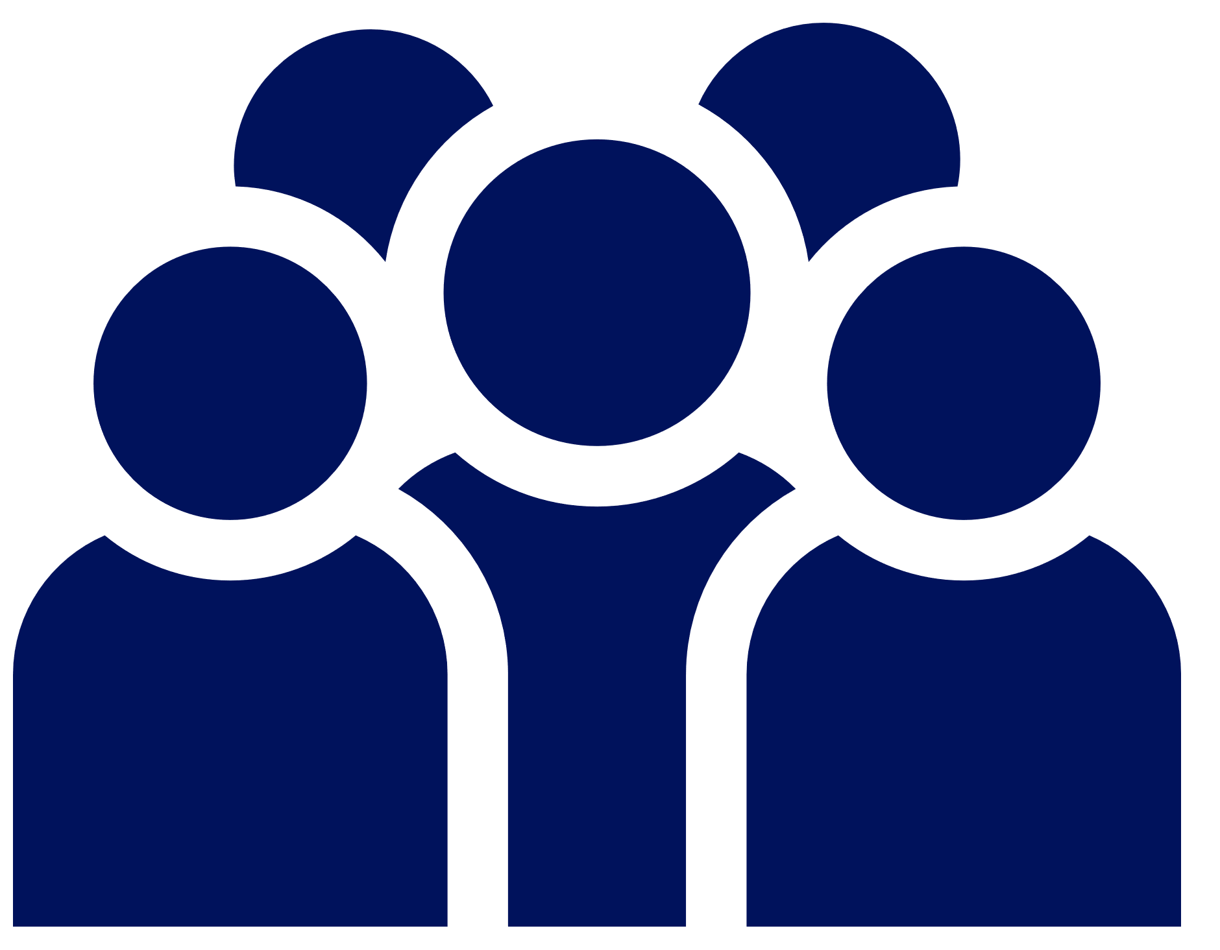
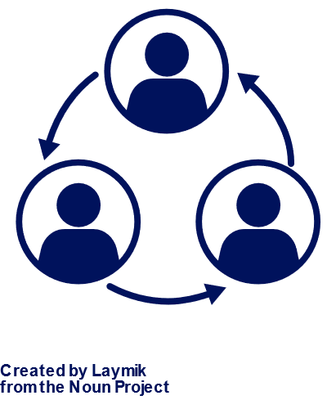
Africa – EU Green Energy Initiative (AEGEI) launched in 2022
12 EU member states participating
10 EU financing institutions
ENERGY in Africa
Globally, 733 million people, including more than 570 million in sub-Saharan Africa, still do not have access to electricity.
Priorities :
Access to energy for all
Regional electricity interconnections and market integration
Renewable energy generation
Energy Transition Partnerships in Africa
Green Hydrogen production in Africa
A
Additional renewable energy generation capacity
B
People with access to energy by 2030
100 – 200 M
One Stop Shop for Green Energy Investments
The peak power generation capacity will need to be increased 2.5 times by 250GW by 2040
1
Physical Infrastructure
2
Enabling Environment

Slide 5
Case study : Nachtigal Hydroelectric power station (Cameroun)
Design, construction, and operation over 35 years of a 420 MW hydropower plant by a European company - Electricité de France (EDF)
Construction started in March 2019 and the commissioning is scheduled for autumn 2024 using the highest environmental standards
The financing of the project is based on a pool made up of major international development institutions but also local banks :
NHPC (Nachtigal Hydro Power Company) with additional shareholders: EDF (40%), AFRICA 50 (15%), IFC (20%), STOA (10%), and Government of Cameroon (15%)
KEY FIGURES
Capacity: 420 MW
6 million people will benefit from better energy supply
Investment: EUR 1.2 billion
#GlobalGateway #TeamEurope

Slide 6

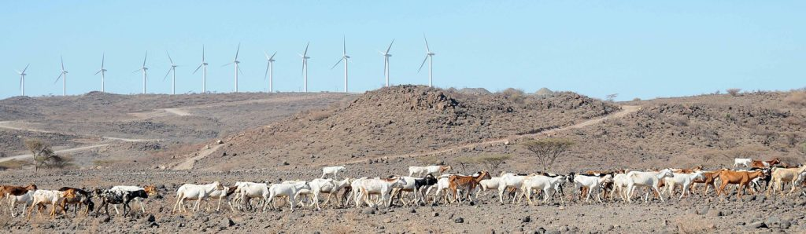
Renewable energy :
Lake Turkana wind power project (KENYA)
With an investment of EUR 620 million, Lake Turkana Wind Power is the single largest Public-Private Partnership investment in Kenyan history, and its success has reinforced the country’s status as a safe and reliable investment destination.
The EU provided a EUR 25 million equity contribution and a EUR 200 million loan, a huge vote of confidence to the proj­ect, which was crucial in crowding in the required funds.
KEY FIGURES
310 MW installed
1,126,808 people with new access
469,098 tons CO2eq/year avoided

Slide 7
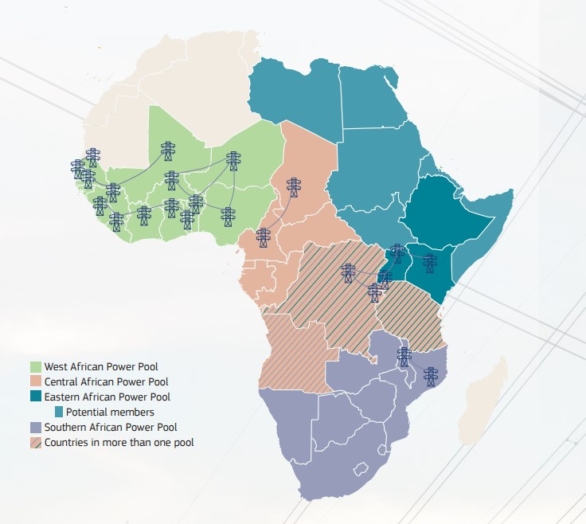
The African continental power system an example of Africa-EU energy partnership
The cooperation between Africa and EU on energy is very strong, EU is Africa's main partner both on investments and in two flagship continental actions
The Single African single electricity market (AFSEM) policy that was adopted on February 2021
The Continental Power System Masterplan (CMP) where the EU together with IRENA is also Africa’s main partner in developing an energy plan for the future and for energy transition
Notes:
Where to find data on results?

Slide 8
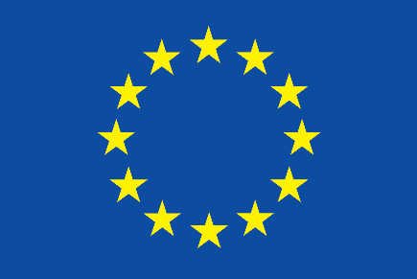
    Thank you
    INTPA-GLOBAL-GATEWAY@ec.europa.eu
    T
THANK YOU
INTPA-GLOBAL-GATEWAY@ec.europa.eu
One Stop Shop for energy investments
#Global Gateway #Team Europe

