Slide 1
Global Gateway decarbonising maritime transport
Giuseppe Izzo
Unit for Sustainable Transport and Urban Development
of DG for International Partnerships
Athens, 30th November 2023
#TeamEurope #GlobalGateway

Slide 2
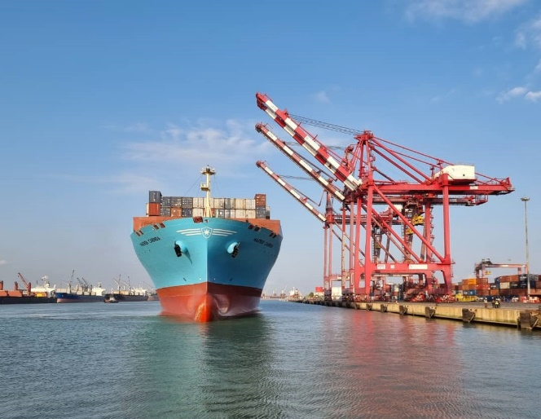
Transport as an investment priority for Global Gateway
Focus on physical infrastructure, cleaner vehicles as well as sustainable and green fuels to strengthen digital, transport and energy networks
#GlobalGateway #TeamEurope

Slide 3
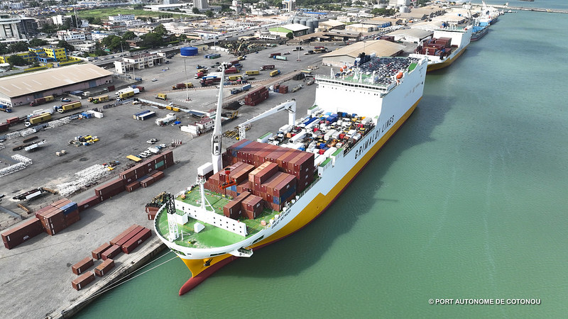
Maritime Transport
Background
Maritime transport is essential for the EU as it accounts for around 75 % of the Union’s external trade and 31 % of its internal one.
400 million passengers embark or disembark annually in ports of EU Member States.
© Port Autonome de Cotonou
#GlobalGateway #TeamEurope

Slide 4
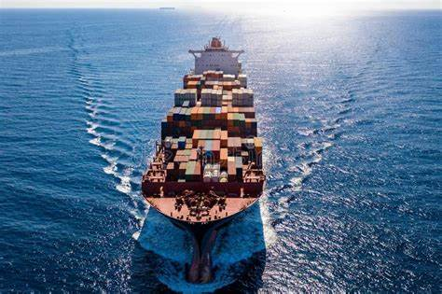
Decarbonization of maritime transport
Maritime transport represents 3 to 4% of the EU's total CO₂ emissions.
The “FitFor55” package includes different instruments helping the shipping sector to decarbonize the EU.
FuelEU Maritime Regulation will require the reduction of the greenhouse gas intensity of the energy used onboard ships from 2% by 2025 (to as much as 80% by 2050).
This regulation is complemented with the extension of the EU Emissions Trading System (EU ETS) to shipping, and the Alternative Fuels Infrastructure Regulation (AFIR).
#GlobalGateway #TeamEurope

Slide 5
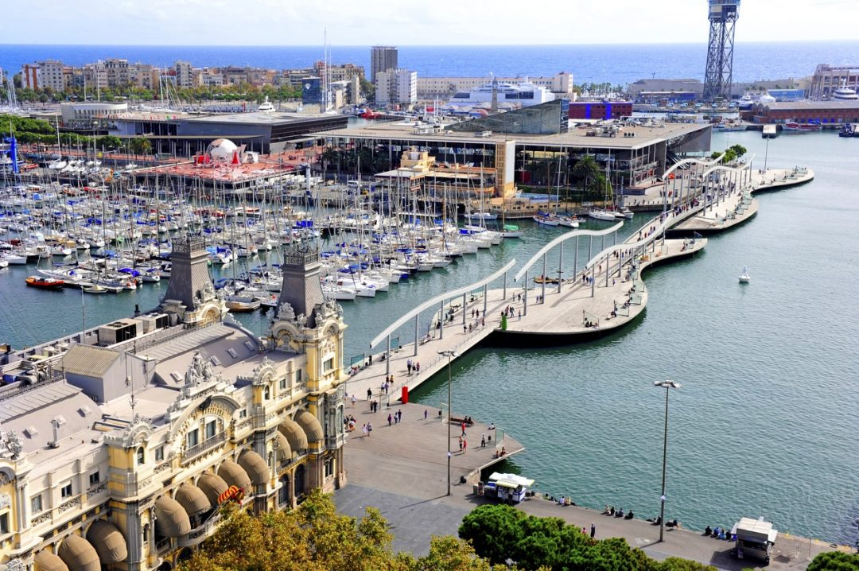
Ports are playing an important role: a good example is EC collaboration with different ports authorities in Europe that act as gateways for trade with Africa (an example is the cooperation of ports of Antwerp and Bruges with the port of Cotonou in Benin, as well as with ports in Malaysia, Nigeria and Tanzania)
Challenges and opportunities
Ports are playing an important role: a good example is the EC collaboration with ports authorities in Europe that act as gateways for trade with Africa (e.g. the cooperation of ports of Antwerp and Bruges with the port of Cotonou in Benin, and the ports in Malaysia, Nigeria and Tanzania).
Cooperation with EU ports
The challenges of decarbonisation
for the European ports offer great opportunities.
Ports can become green hubs for the production and distribution of renewable energy and alternative fuels, and for recycling and waste management.
Excellent EC collaboration is ongoing with ports authorities and shipping companies in Europe: several major ports are committed to decarbonization of maritime transport (e.g., Antwerp, Rotterdam).
Port of Barcelona©
#GlobalGateway #TeamEurope

Slide 6
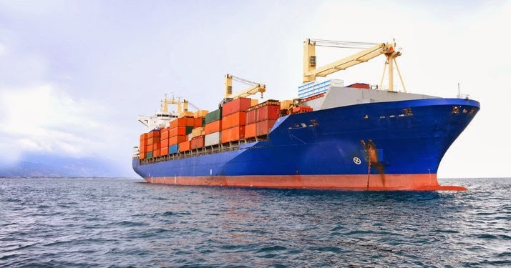
Global Maritime Shipping Corridors
The Global Gateway included in 2023 a flagship on Global Maritime Green Corridors.
It foresees: the support to research and innovation to get renewable fuels available in the market and optimise logistics routes, the production of renewable fuels outside the European Union (as the ships need to bunker in other parts of the world).
The initial production target is of 6 million tonnes per year of methanol for green shipping.
In 2023 private sector participants will finalise the feasibility study for the 1st phase in Morocco and Egypt.
#GlobalGateway #TeamEurope

Slide 7
Conclusions
The frame of the Global Maritime Green Corridor is a win-win situation for all the actors: the European Commission is considering the extension of this initiative to a more comprehensive flagship.
DG INTPA via the EU Delegations promotes the organization of business fora at regional or country levels (in Africa, Asia and Latin America) to develop networks of European and local business operators.
This initiative is an important opportunity to contribute to the decarbonisation of transports and to the sustainable growth in Europe and in the world.
We can positively contribute to many aspects of the maritime sector: port updates and rehabilitation, promotion of technologies to decarbonise ships (retrofitting), production of sustainable renewable fuels.
The Global Gateway contributes to create strong and sustainable links between Europe and the world and promote European values.

Slide 8
Thank you INTPA-GLOBAL-GATEWAY@FOR ec.europa.eu T
THANK YOU FOR YOUR ATTENTION
#Global Gateway #Team Europe

