Slide 1
Global Gateway in practice: flagship projects in the neighbourhood in the energy and digital sector
Alexandre Darras
Thematic Officer Sustainable Connectivity, Green Transition and Global Gateway
European Commission, DG NEAR
Thursday, 30th November 2023
#TeamEurope #GlobalGateway

Slide 2
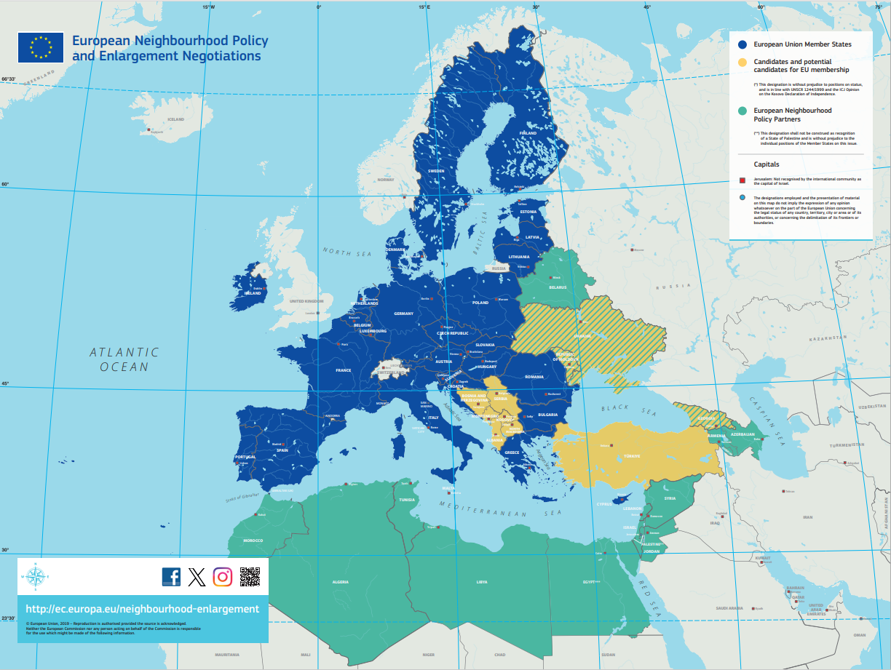
What is the Neighbourhood and Enlargement region covered by DG NEAR ?
#GlobalGateway #TeamEurope

Slide 3
How is Global Gateway implemented in the NEAR region ?
The Economic and Investment Plans (EIPs) are the regional implementation of GG in Neighbourhood and Western Balkans
Three EIPs:
- Eastern Partnership
- Southern Neighbourhood
- Western Balkans
Same priority sectors as the rest of GG: digital, climate & energy, transport, health, education & research + important focus on private sector/SMEs development
Ambition to mobilise EUR 77 billion in investments between 2021 and 2027. On good track to deliver: currently EUR 44 billion expected mobilised investments through 484 operations.
#GlobalGateway #TeamEurope

Slide 4
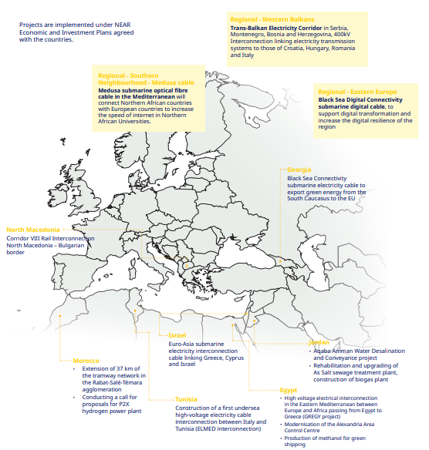
Example of the Global Gateway flagship projects 2023 in NEAR
#GlobalGateway #TeamEurope

Slide 5
Flagship: Digital Connectivity MEDUSA – regional North Africa
€342 M
total investment (estimated)
Partner countries
Algeria, Egypt, Morocco, Tunisia
Objectives
7,100 km high-capacity optical-fibre submarine cable to connect both shores of the Mediterranean Sea. It will integrate 500 universities and research centres from these countries into “EU essential terabit R&D network”. They will receive a 200 Giga bits per second connectivity for the next 20 years. SMEs will also benefit from this enhanced connectivity.
Partners
EU, EIB; AFR-IX Telecom, Alcatel Submarine Networks, ASREN, GEANT, Orange
Implementation stage
- Grant contribution agreement NEAR-EIB signed in July 2023.
- Launch of phase 1 of the project in 2024.
- The project will be operational between 2025 and early 2026 (design life of 25 years)
#GlobalGateway #TeamEurope

Slide 6
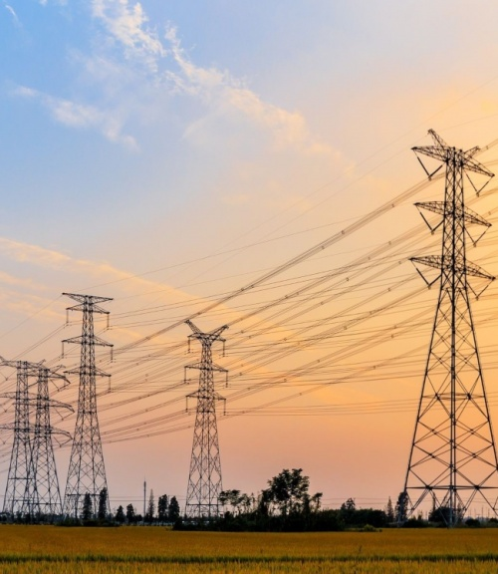
Clean energy / Flagship 5: Transition from coal Trans-Balkan Electricity Corridor
€290 M
total investment (estimated)
Partner countries
Serbia, Bosnia and Herzegovina (BiH) and Montenegro
Objectives
Establishing a Trans-Balkan Power Corridor to connect the electricity transmission systems from Serbia, Montenegro, Bosnia and Herzegovina to Croatia, Hungary, Romania and Italy through either 400 kV overhead lines or submarine cable.
Partners
EU and MS (WBIF grant), KfW, EBRD
Implementation stage
- A section was completed in June 2022 (Kragujevac – Kraljevo).
- Works tender launch for next section (Obrenovac – Bajina Bašta section) expected in Q1 2024 and works start planned for Q3 2024
#GlobalGateway #TeamEurope

Slide 7
Clean energy / Flagship Energy Connectivity GREGY project
€3.5 Bn
total investment (estimated)
Partner countries
Egypt and Greece
Objectives
A high-voltage electricity interconnection in the Eastern Mediterranean between Europe and Africa passing from Egypt to Greece. The purpose would be to transmit 3 GW of green power, generated by solar and wind parks in Egypt, to the EU via Greece.
Partners
Greece and other partners. Being determined.
Implementation stage
Feasibility study to be finalised.
Since 25 October 2023, project retained in list of projects of mutual interest (PMI). Formal adoption by EC expected end November and then scrutiny of Council and EP at the beginning of 2024.
#GlobalGateway #TeamEurope

Slide 8
Thank you INTPA-GLOBAL-GATEWAY@ec.europa.eu T
THANK YOU
#Global Gateway #Team Europe

