Slide 1
Engaging with the private sector in Global Gateway
Laura Atienza Urcelay
Team leader, Private sector engagement,
DG International Partnerships, INTPA.E3
Thursday, 30th November 2023
#TeamEurope #GlobalGateway

Slide 2
Global Gateway and the private sector
The European private sector contributes to implement the Global Gateway Strategy. To set out a competitive and joint European offer to our partners, we need to mobilise the private sector and make best use of:
Joint political and policy dialogues coordinated by EU Delegation and headquarters
Dialogue at country level and EU business fora
Business Advisory Group
Technical assistance to improve capacities of local administration or support local business as competent partner for European investors
EU guarantees to de-risk private investments and blending programmes: EFSD+ Open Architecture (sharepoint.com)
Export Credits
Investments of public development banks like EIB and EBRD (EU level)
#GlobalGateway #TeamEurope

Slide 3
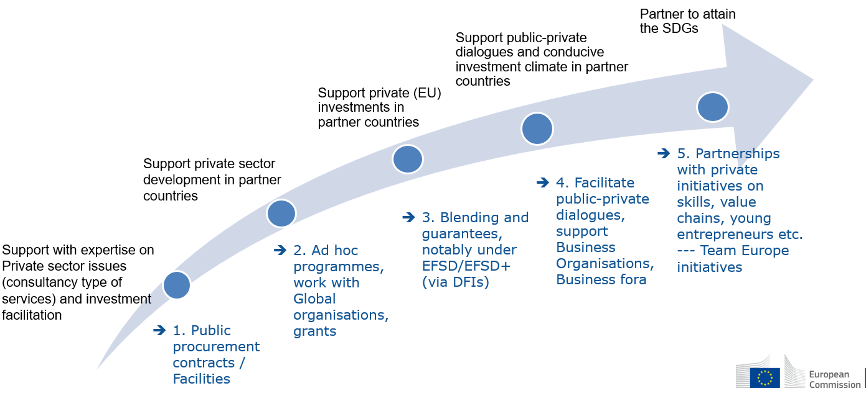
Engaging with businesses

Slide 4
Global Gateway and the private sector
Flagship example: The EU-Nigeria Digital Economy Package (2021-2024)
Under its Global Gateway initiative, the EU plans to invest at least €820 million in Nigeria’s digital transformation.
With a combination of €160 million in grants and €660 million in loans, the EU aims to comprehensively support Nigeria’s digitalisation strategy.
Digital
infrastructure
investments
Digitalisation
of public
services
Digital
entrepreneurship
Digital skills
Including
Digital
governance
Notes:
Digital infrastructure investments:
- The EU will support building the fibre optic cables and data centres needed to improve Nigerian’s access to high-speed connectivity.
- The European Investment Bank will invest €100 million to expand secure 4G connectivity in Lagos and Ogun states and triple national data capacity.
Digitalisation of public services:
- The EU will support the digitalisaton of Nigeria’s administration to allow better and more accessible public services to citizens.
- The European Investment Bank is investing €250 million to strengthen Nigeria’s digital identity infrastructure with the highest data protection standards.
Digital entrepreneurship:
- The EU will support the creation and scaling up of tech start-ups and boost innovative solutions for Nigeria’s society and economy.
- Through a €9.5 million grant to the Nigeria Innovation Programme, the EU will promote innovation-friendly ecosystems and new digital solutions.
Digital skills:
- The EU will support the development of the skills needed for Nigerians to succeed in the digital economy, with a focus on youth and women.
- As part of a €44 million grant to the Nigeria Jubilee Fellowship Programme, the EU will support on-the-job training for young Nigerians in the ICT sector.
Digital governance:
- The EU will support the development of regulatory frameworks with the highest standards of privacy, safety and cybersecurity, while promoting an open internet and digital market that upholds citizens’ rights.
- The EU will engage in policy dialogue and set up a dedicated €2 milliontechnical assistance facility to share expertise and build up administrative capacity.

Slide 5
Global Gateway and the private sector
To participate in this joint endeavour, the EU private sector has the following entry points:
Get in touch with governmental representatives
Approach the EU Delegation in partner countries
Get in touch with the national development banks
Take part in EU Business Fora:
https://capacity4dev.europa.eu/groups/eu-private-sector-engagement_en
Get in touch with European Business Organisations in partner countries (and in Brussels), and Trade Promotion Organisation
https://www.europe-tpo.com/;
https://eboworldwide.eu/
#GlobalGateway #TeamEurope

Slide 6
Global Gateway and the private sector
Monitor the Portal of public tenders:
https://ec.europa.eu/info/funding-tenders/opportunities/portal/screen/home;
https://ted.europa.eu/TED/browse/browseByMap.do (only for upcoming tenders)
Monitor the Business Advisory Group’s developments through sectoral associations/EU business associations:
https://capacity4dev.europa.eu/groups/eu-private-sector-engagement_en
#GlobalGateway #TeamEurope

Slide 7
List of 2024 EU Business Fora
EU Business Fora | Capacity4dev (europa.eu)
Country / Region | Date | Link to Global Gateway
Cameroon – European Union Business Week | 21-23 February 2024 Yaoundé | Sectors: agriculture, energy, circular economy, mining, transport and logistics, digital
Uganda | 5-7 March 2024 | Sectors: agri-business, mining, energy, digital, tourism
Zambia | 10-12 April 2024 Kitwe | Focus on copper value chain EU-Zambian Business Forum Registrations: Link Objective: identify and build commercial partnerships between actors in the copper value-chain, and to explore potential areas of value-addition in the copper-sector in Zambia
#GlobalGateway #TeamEurope

Slide 8
List of 2024 EU Business Fora
Country / Region | Date | Link to Global Gateway
Nepal | May 2024 Kathmandu | Sectors: to be announced
Argentina | Q3/Q4 2024 Buenos Aires | Sectors: to be announced
Ghana | Q2 2024 | Sectors: to be announced
9th EU-Nigeria Business Forum | 2024 | https://eunigeriabusinessforum.com/
#GlobalGateway #TeamEurope

Slide 9
Thank you INTPA-GLOBAL-GATEWAY@ec.europa.eu T
THANK YOU
#Global Gateway #Team Europe

