Slide 1
Team Europe
Workshop with businesses and private sector in Athens
Thursday 30th May 2023
DG International Partnerships, European Commission
#TeamEurope #GlobalGateway

Slide 2
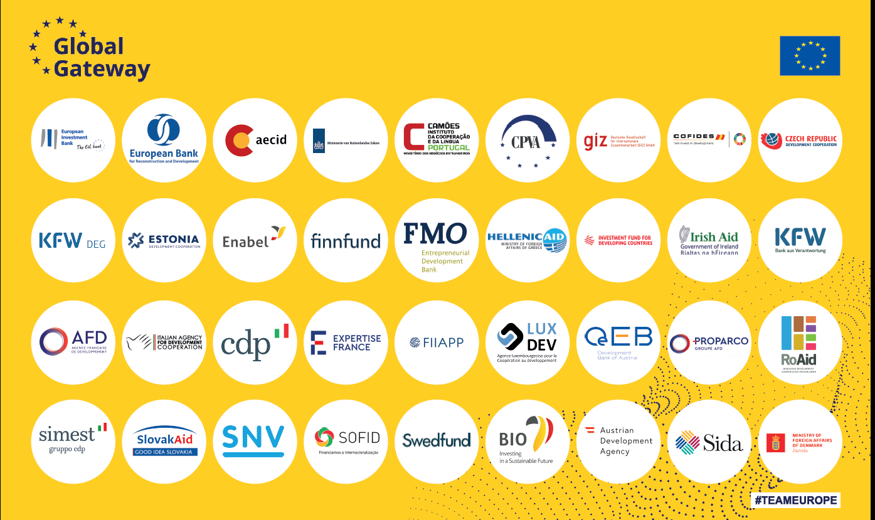
Team Europe
European Credit Agencies
Notes:
Consists of the EU, its Member States, their diplomatic network, finance institutions including national development banks, and implementing agencies, as well as the European Investment Bank (EIB) and the European Bank for Reconstruction and Development (EBRD).
Implementing Global Gateway in a Team Europe approach is based on a strong process of coordination in Brussels, in Member States, and in partner countries. It requires a whole-of-Commission and EEAS approach and a similar whole-of-government approach in Member States (all relevant Ministries, development agencies, development financial institutions, export credit agencies…) alongside, and supporting, the private sector. Team Europe actors in partner countries (EU Delegations, Member States Embassies and Member State agencies, their development financing institutions, the EIB and EBRD) are at the centre of the implementation and have a crucial role in exchanging information on investments priorities and private sector views that inform strategic guidance. EU Delegations play a central role.

Slide 3
COORDINATION PLATFORMS
Team Europe approach
European Development Finance Institutions (EDFI)
Joint European Financiers for International Cooperation (JEFIC)
Practitioners’ Network
EIB, EBRD

Slide 4
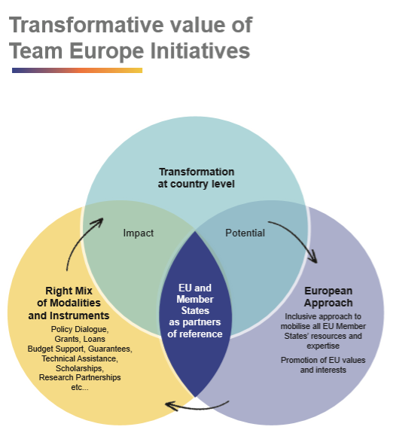
Team Europe: implementing Global Gateway
Team Europe Initiatives
Transformational potential and impact
In line with EU policy priorities, NDICI targets & national development plans
Tackling major development bottlenecks
European approach
At least 3 TE members financially involved
Inclusive approach
Right mix of modalities, tools, expertise
Building a unique European offer, w/ ‘sustainability’ label at its core
#Global Gateway #Team Europe
Notes:
Global Gateway captures what the EU stands for as a partner and is delivered predominantly by Team Europe and through Team Europe Initiatives (TEIs).
Global Gateway = The brand / offer / overarching strategy
Team Europe = The approach
TEIs = The substance (flagships / projects)

Slide 5
Linkages TEI and the 2023 GG flagship projects
 | DIGITAL | CLIMATE AND ENERGY | TRANSPORT | HEALTH | EDUCATION & RESEARCH
AFRICA | 3 | 7 | 7 | 2 | 2
LAC | 2 | 4 | 0 | 3 | 1
ASIA | 2 | 10 | 3 | 0 | 0
NEAR | 3 | 5 | 4 | 0 | 0
TOTAL | 10 | 26 | 14 | 5 | 3
 | 58 (out of 87 in total = 67%)

