Slide 1
Global Gateway
Luc Bagur
Director for Sustainable Development Policy and Coordination
European Commission, DG INTPA
Thursday, 30th November 2023
#TeamEurope #GlobalGateway

Slide 2
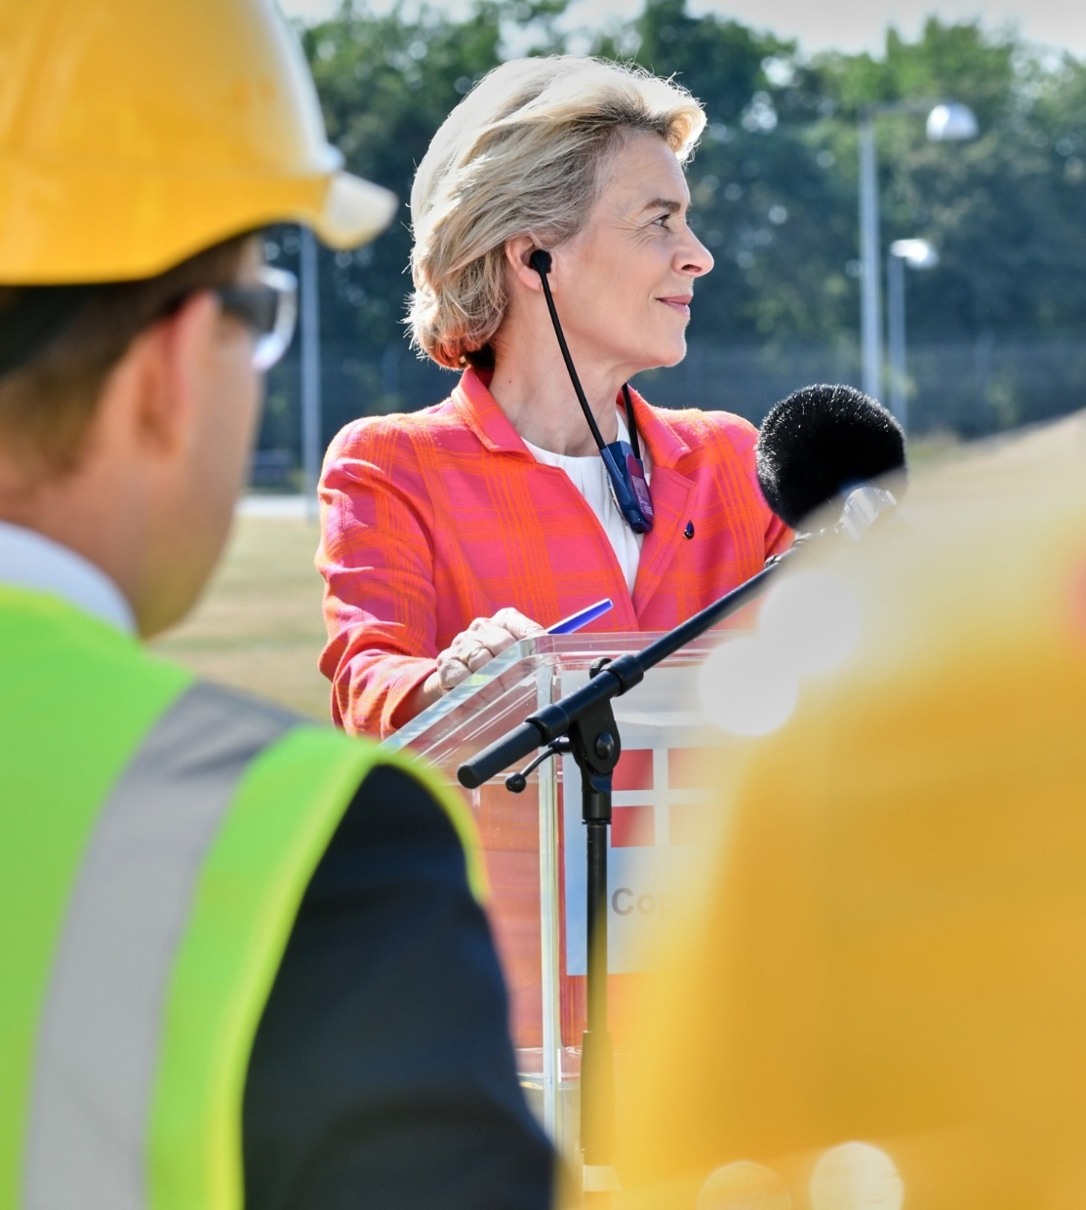
“The Global Gateway Strategy is a template for how Europe can build more resilient connections with the world.”
Ursula von der Leyen,
President of the European Commission
#Global Gateway #Team Europe

Slide 3
Global Gateway – what is it ?
Value-based, positive offer to partner countries
2030 Agenda and the SDGs
Needs of partner countries with a stronger assessment of the EU’s strategic interests
Team Europe approach, mainly through Team Europe Initiatives
EC, EIB, EBRD; all relevant ministries, development agencies, development finance institutions, export credit agencies, private sector
Whole-of-government approach
Mobilise up to EUR 300 billion of investments
#GlobalGateway #TeamEurope

Slide 4
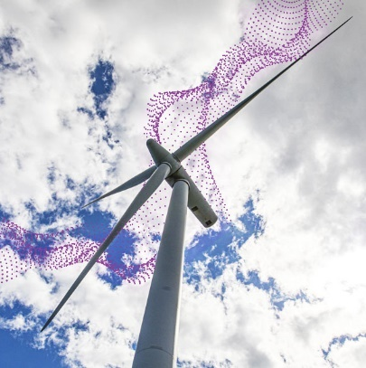
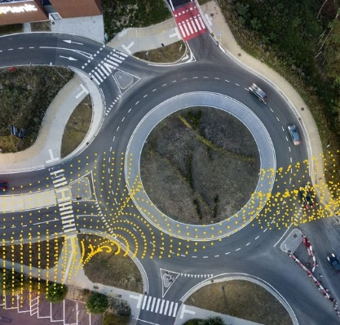
Digital
The EU will support open and secure internet
Climate and energy
The EU will support investments and rules paving the way to the clean energy transition
Transport
The EU will support all modes of green, smart and safe transport
Education and research
The EU will invest in
high quality education, with a focus on girls
and women and vulnerable groups
Health
The EU will help strengthen supply chains and local vaccines production
Democratic values
and high standards
Good governance
and transparency
Equal
partnerships
Green
and clean
Security
focused
Catalysing private
sector investment

Slide 5
How is Global Gateway implemented?
Mix of grants, concessional loans, guarantees to de-risk private sector investments
Combined with operational tools such as technical assistance, policy and economic dialogue, trade and investment agreements and standardization to create better conditions for quality investments
Private sector participation is key – they bring private capital – which we can embed in broader support such as policy reform, standards, training, etc.
#GlobalGateway #TeamEurope

Slide 6
Global Gateway Governance
Global Gateway Board
Global Gateway Board provides strategic guidance
Private sector role
Business Advisory Group,
building on existing platforms and networks,
ensure intensive consultation with the private sector
Civil society
Dialogue with civil society will build on existing platforms
International fora
Global Gateway – EU and MS investment packages built for major summits, a priority for discussion in multilateral fora
#GlobalGateway #TeamEurope

Slide 7
State of play
Global Gateway Board provided strategic guidance in December 2022
List of Global Gateway flagship projects to cover over 200 projects worldwide
Further alignment of full toolbox: involvement of private sector (BAG), potential of Export Credit Agencies
Methodology to track total investment implemented under Global Gateway being discussed in Council
GG communication strategy in place, toolkit being prepared
Joint missions to partner countries to strengthen visibility

Slide 8
Thank you INTPA-GLOBAL-GATEWAY@ec.europa.eu T
THANK YOU
INTPA-GLOBAL-GATEWAY@ec.europa.eu
#Global Gateway #Team Europe

