Slide 1
Voluntary Peer Review Mechanisms in support of Sustainable Development in the Mediterranean
Mr. Julien Le Tellier
UN Environment / Mediterranean Action Plan – Barcelona Convention Secretariat
© Mathieu Foulquié

Slide 2
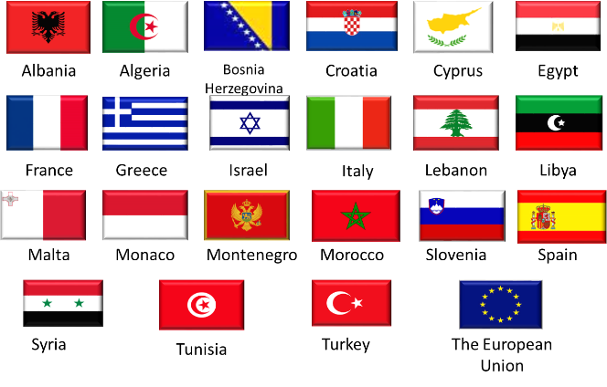
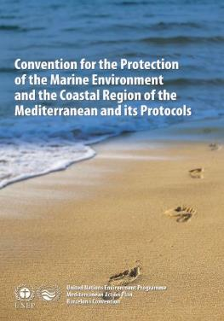
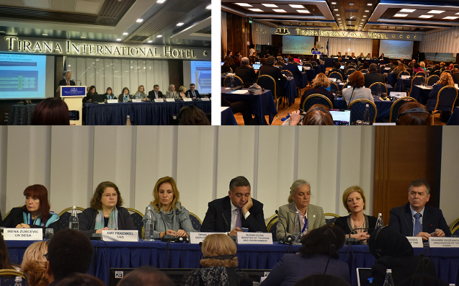
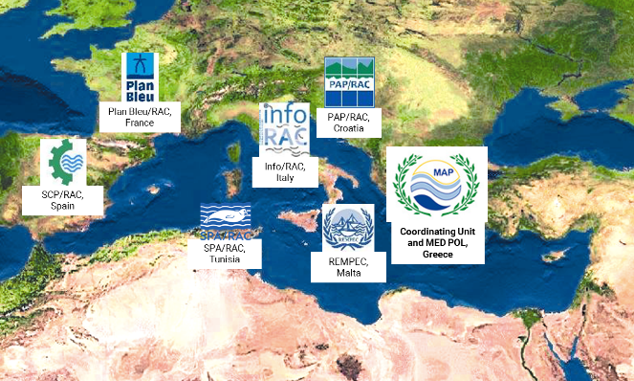
The MAP – Barcelona Convention system
The Parties
The Barcelona Convention
COP 20, Tirana, Dec. 2017
The Secretariat
Notes:
Created in the 70’s more than forty years ago under the UN Environment Programme, the Mediterranean Action Plan (MAP) and Barcelona Convention are Regional Multilateral Environmental Agreements that represent the only legally-binding set of instruments and policies for protecting marine and coastal ecosystems in the Mediterranean.
This regional cooperation framework gathers the 21 riparian countries of the Mediterranean basin and the EU, as CPs to the BC.
These 22 CPs agreed on a common transformative agenda for regional cooperation, partnership and solidarity, “to protect and enhance the marine environment (and) to contribute towards sustainable development of the entire region”.
Allow me to remind that 14 of the CPs to the BC are also UNECE Members: Albania, Bosnia and Herzegovina, Croatia, Cyprus, France, Greece, Israel, Italy, Malta, Monaco, Montenegro, Slovenia, Spain, and Turkey.
The MAP system works towards a peaceful, prosperous and sustainable Mediterranean region, in which societies enjoy a high quality of life within healthy marine and coastal ecosystems.
The Coordinating Unit of the MAP – BC is hosted by Greece in Athens and supervises the work of several specialized Regional Activity Centres, based in Spain, France, Italy, Croatia, Malta and Tunisia.

Slide 3
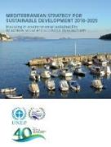
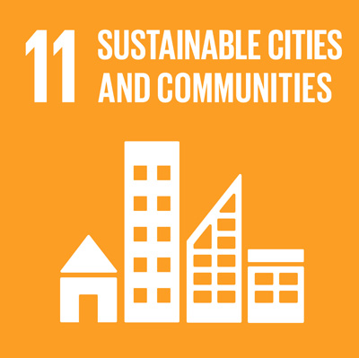
Global / Regional Interactions on Sustainable Development
Global | Regional (Mediterranean)
2030 Agenda and Sustainable Development Goals (SDGs) | Mediterranean Strategy for Sustainable Development (MSSD)
High-Level Political Forum (HLPF) | Mediterranean Commission on Sustainable Development (MCSD)
Volunteer National Review (VNR) | Simplified Peer Review Mechanism (SIMPEER)
SDG Index and Dashboards | Mediterranean Sustainability Dashboard

Slide 4
Linking the objectives of the MSSD 2016-2025 to the SDGs
MSSD Objectives | UN-SDGs
1. Ensuring sustainable development in marine and coastal areas
2. Promoting resource management, food production and food security through sustainable forms of rural development
3. Planning and managing sustainable Mediterranean cities
4. Addressing climate change as a priority issue for the Mediterranean
5. Transition towards a green and blue economy
6. Improving governance in support of sustainable development
4
Notes:
The first column of this table lists the 6 overall objectives of the MSSD.
A number of SDGs are of primary interest for the MAP system, particularly the SDG 14 focusing on conservation and sustainable use of the oceans.

Slide 5
SIMPEER of National Strategies on Sustainable Development (NSSDs)
Voluntary basis
SDGs specifications
A tool to assist CPs
to implement and monitor their work on SDGs and Environmental Conventions
through the means of the MSSD/NSSDs
Dialogue
MSSD 2016-2025 implementation and monitoring
Agreed methodology
Mutual learning, equal participation
Improvement from past experiences…
Exchanges of experiences, policies and good practices…
Scrutiny framework between reviewed and reviewer countries
5

Slide 6
Process and outputs
Desktop Analysis & Questionnaire
Draft Background Report and National Factsheet
Country Mission Report
National Report
Peer Review Meeting
(3 countries)
Fundamental dimensions of the NSSD analysis:
Leadership
Completeness, Integration (SD components, multi-sectoral)
Governance (inclusiveness, participation, partnership)
Resources, and means of implementation
Monitoring
6

Slide 7
Thank you
Julien LE TELLIER, United Nations Environment Programme
Coordinating Unit for the Mediterranean Action Plan
Vassileos Konstantinou 48, Athens 11635, Greece
Julien.Letellier@un.org
www.unepmap.org

